Slide 1

Causal Impact
Analysis Using R
Name
eCommerce Insights Team
Date
Bridget Fitzpatrick
Data Scientist
bridget.fitzpatrick@dcsg.com

Slide 2

Possible Causal Relationship
Motivating Question
Arya Stark
After facing a long-feared enemy in Season 8, did “Arya Stark” grow in popularity as a search term?

Slide 3
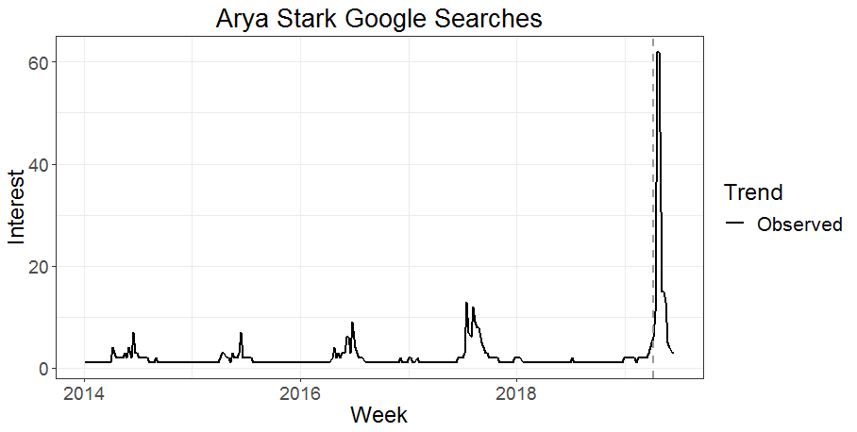
Possible Causal Relationship
Observed Trend
“Arya Stark” did grow in popularity, but would this have happened regardless of her battle?
Source: Google Trends

Slide 4
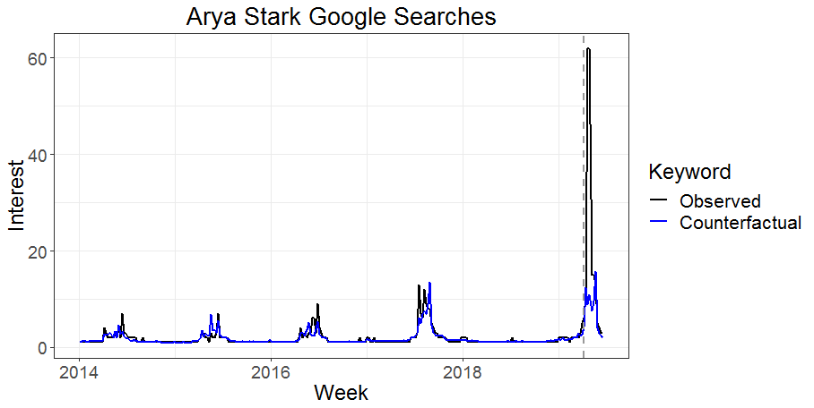
Possible Causal Relationship
Observed Trend vs Counterfactual
We want to know what would have happened without the battle in order to estimate the true causal impact.
Causal Impact
Source: Google Trends

Slide 5
Identifying Causal Relationships
Randomized Experiment
Gold standard for estimating causal effects
Examples: Clinical drug trials, website experience testing, behavioral experiments
Results with no treatment applied
Control Group
Identify
Population
Randomly sample and split in two groups
Causal Impact
Treatment Group
Results with
treatment applied

Slide 6


Identifying Causal Relationships
Causal Impact Analysis
Randomized experiments can be unethical, too costly, or impossible to perform
Examples: National change in minimum wage, company going public, launch of a new product
Results with no treatment applied
No
?
Counterfactual
Does Arya Stark
face her enemy?
Causal Impact
Yes
Results with
treatment applied

Slide 7
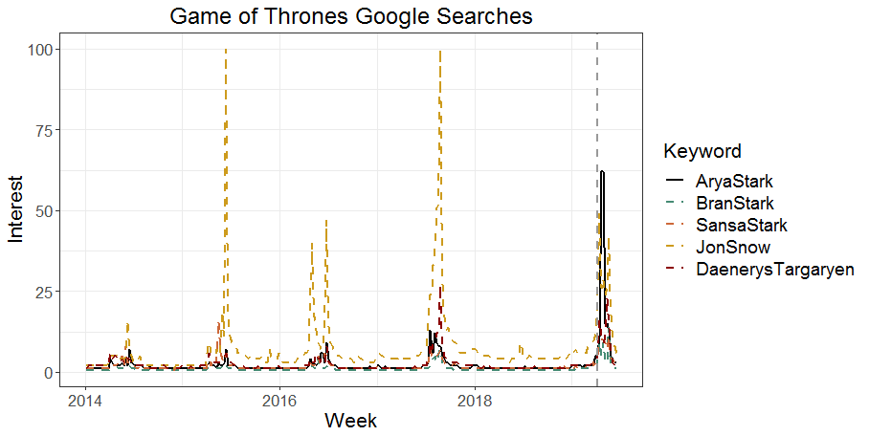
Causal Impact Methodology
Identify Correlated Data Series
Identify other data series that
Are well-correlated with the data series of interest in the pre period
You expect would be correlated in the post period if the intervention had not occurred
Source: Google Trends

Slide 8




Causal Impact Methodology
Bayesian Approach to Estimation
Estimation of the counterfactual is iterative, with a default of 1,000 iterations
 | Bran Stark | Sansa Stark | Jon Snow | Daenerys Targaryen
Iteration 1
Iteration 2
Iteration 3
Iteration 4
…
Counterfactual

Slide 9
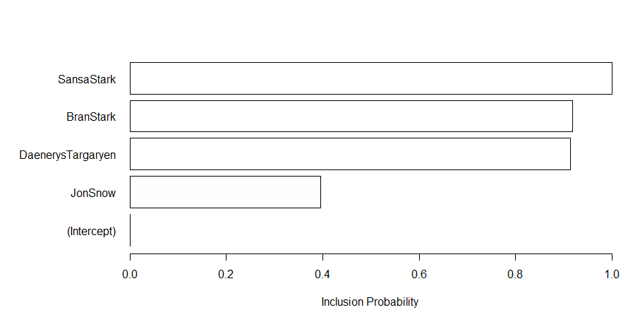
Causal Impact Results
Check Likelihood of Inclusion in Counterfactual
White bars indicate positive correlation, while gray bars would indicate negative correlation

Slide 10
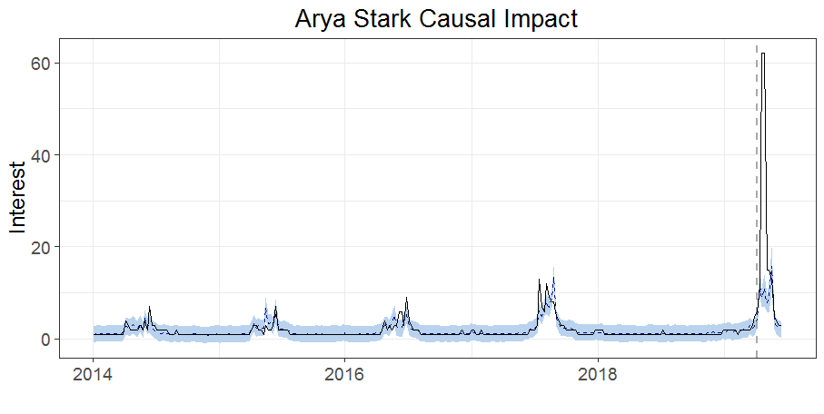
Causal Impact Results
Plot and Statistical Summary
Causal Impact
 | Observed | Counterfactual | Lower 95% CI | Upper 95% CI
Averages | 19 | 7.7 | 6.3 | 8.8
Absolute Effect |  | +12 | +11 | +13
Relative Effect |  | +152% | +137% | +170%
Posterior Probability of Causal Effect: 99.8993%

Slide 11
Using CausalImpact Package
Data of Interest
Footwear Line A was heavily advertised during Nov 2018
Was there an increase in revenue caused by this advertising campaign?
Dates
Pre: 2018-08-18 to 2018-10-31 (business as usual)
Post: 2018-11-01 to 2018-11-30 (advertising campaign)
Additional: 2018-12-01 to 2018-12-15 (check if advertising created lingering effects)
Correlated Data Series
Sports Equipment: Line A
Apparel: Lines A, B, and C
Footwear: Lines B and C

Slide 12
Appendix
Practical Advice
Data of interest
Have about 2 months worth of data for the pre period and 1 month for the post period
Correlated data series
Include more than 1 if possible
Correlation coefficients of .80 and above work best
Do not include correlated data series that were subject to their own treatment
References
Literature
Brodersen KH, Gallusser F, Koehler J, Remy N, Scott SL. Inferring causal impact using Bayesian structural time-series models. Annals of Applied Statistics, 2015, Vol. 9, No. 1, 247-274. http://research.google.com/pubs/pub41854.html
Other resources
Package documentation https://cran.r-project.org/web/packages/CausalImpact/CausalImpact.pdf
FAQs https://cran.r-project.org/web/packages/CausalImpact/vignettes/CausalImpact.html
Video https://www.youtube.com/watch?v=GTgZfCltMm8

